Slide 1
Motif Finding: Basic Graph Theory and NetworkX
Recitation 4 9/20/2024
Caitlin

Slide 2
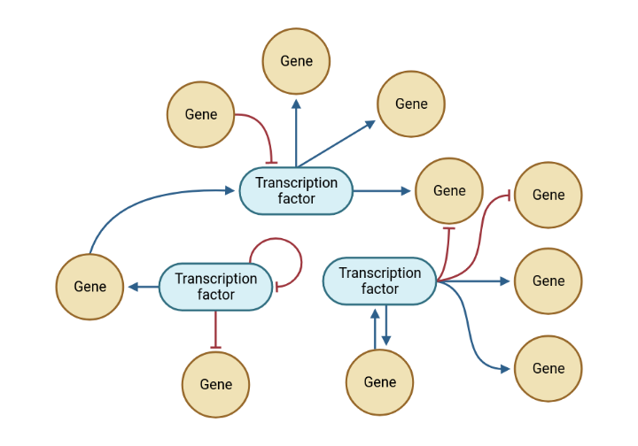
Motif Finding is a Graph Theory Problem!
Gene regulatory networks are unweighted, directed graphs

Slide 3
Graph Theory Basics
Node: A vertex
Edge: A relationship between two nodes
Order: Number of nodes in the graph
Size: Number of edges in the graph

Slide 4
Graph Theory Basics
Graphs can be Directed, Mixed, or Undirected
Degree (of a node): The number of edges connected to the node
In a digraph, there is the concept of ‘in-degree’ and ‘out-degree’
Neighborhood (of a node): Nodes which share an edge with the node
Connectivity
In a digraph, there is the concept of ‘strongly connected’ and ‘weakly connected’
Subgraph: A subset of nodes and edges existing in the parent graph
Isomorphism: Two graphs with the same number of nodes and the same relationships

Slide 5
Framing the Problem of Motif Finding:
Find 1, 2, 3 Node Motif Occurrences
We consider each of these independently
Find autoregulatory loops
For each non-autoregulatory edge, determine if its mono-directional or bi-directional
Find all the weakly connected, degree 3 subgraphs and determine what motif type they are isomorphic to, ignoring autoregulation

Slide 6
Framing the Problem of Motif Finding:
Which subgraphs are isomorphic to which motif?
There are different ways to approach this, and searching for isomorphisms is a non-trivial problem with high computational cost
Recommended approach (minimize number of isomorphism checks):
Create motif ‘classes’ based on graph characteristics like size
Obtain the set of subgraphs to classify from the network of interest
Use graph characteristics to assign subgraphs to the motif classes you created
With the narrowed-down set of possible motifs, check for isomorphism

Slide 7
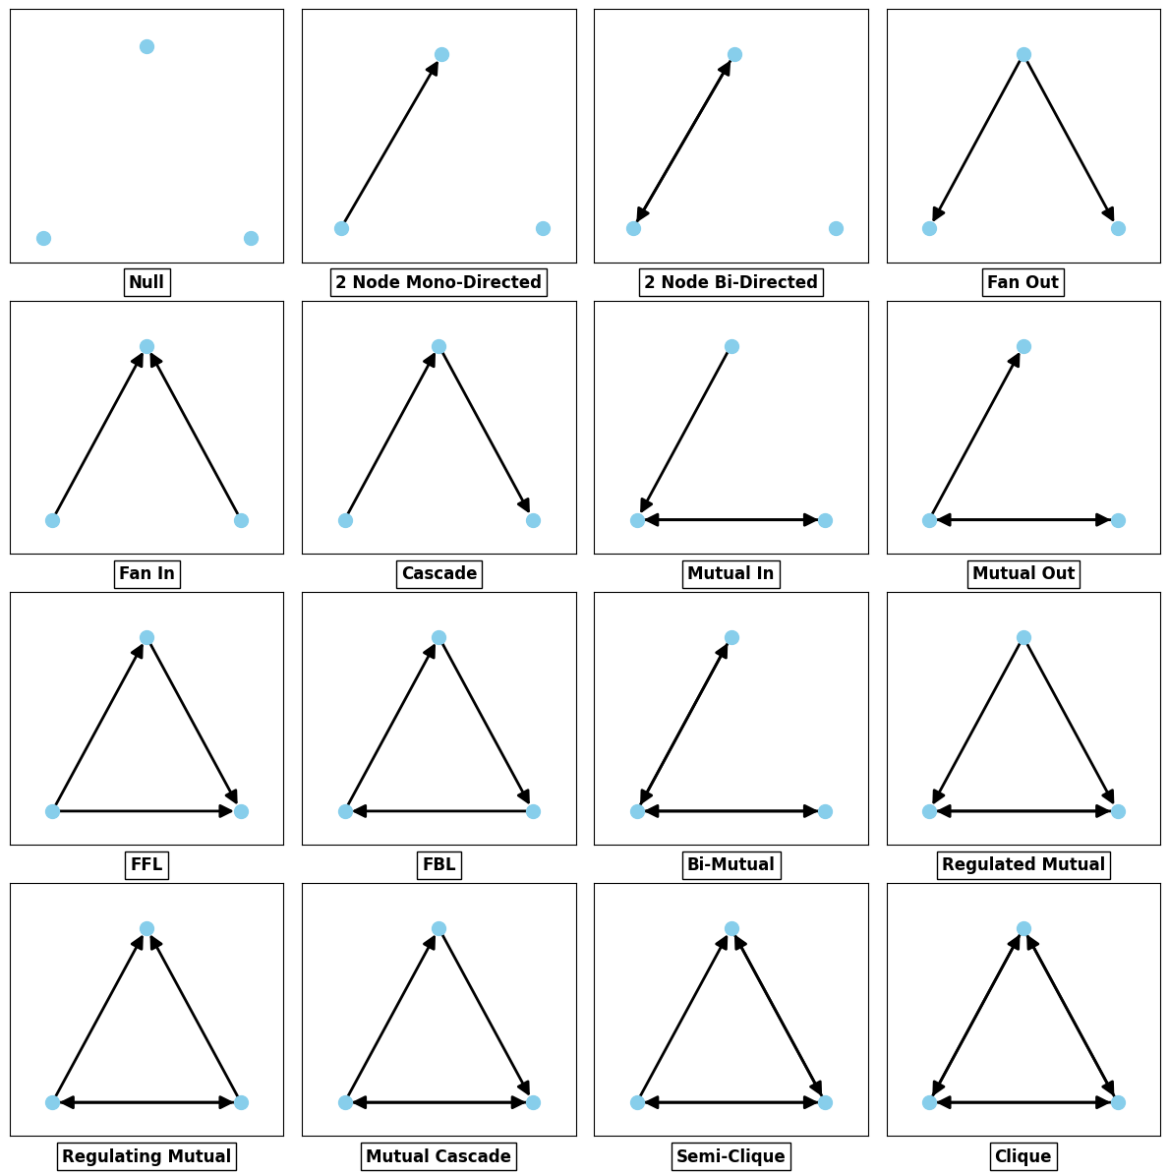
Order 3 Digraphs
We are interested in finding biological subgraphs isomorphic to the latter 13

Slide 8
Introduction to NetworkX

